Slide 1
Group 13
Team Members
*Amul Patwa
*Manoj Preveen
*Naman Bakhru
*Raja Dubey
*Saksham Bhalla

Slide 2
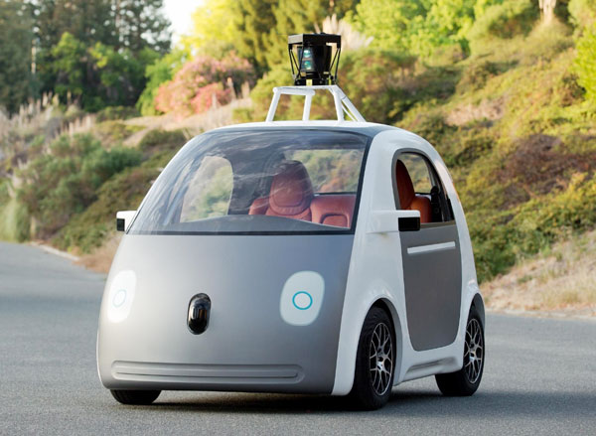
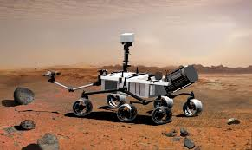
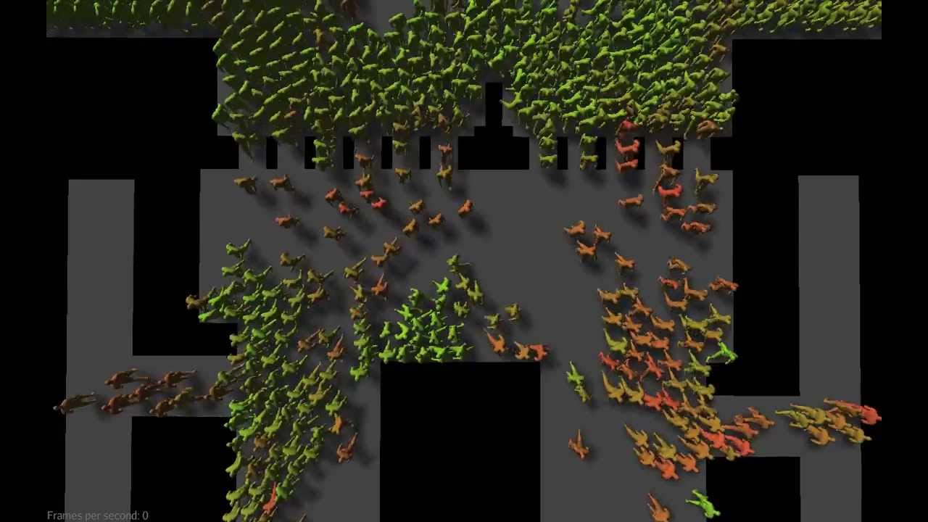

Slide 3
Intelligent Path Planning Using Fuzzy Logic

Slide 4
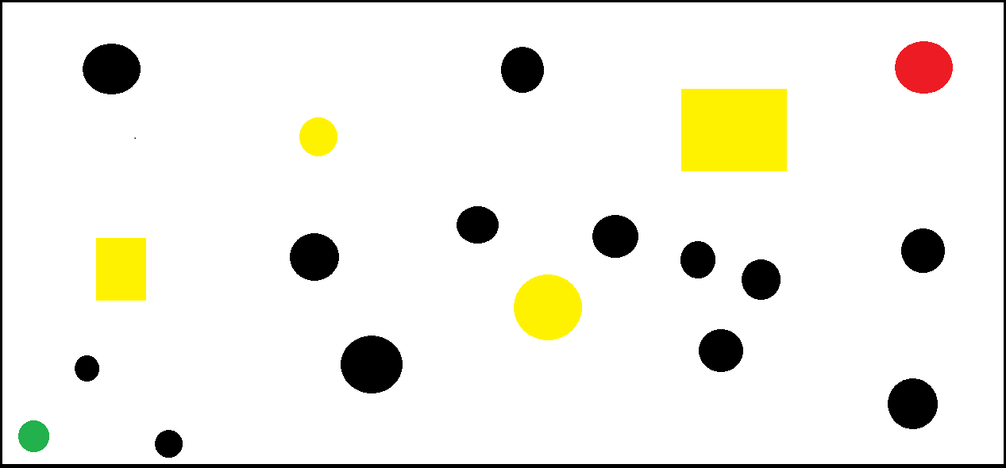
Outlines :
Goal Point
Robot
Static Obstacles
Dynamic Obstacles

Slide 5

THE FUZZY HUMAN PERCEPTION
What we DO ???
Avoiding Nearby Obstacles
Choosing Safest Path
Reaching Goal Point
Integrating Above Logics

Slide 6
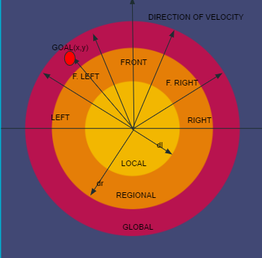
MODEL
DIVISION OF SPACE

Slide 7
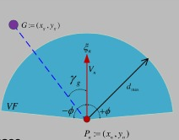
P (X_{n} , Y_{n} ) is the current position of robot
Goal Distance From Robot = d
Angle of Goal w.r.t Direction of Velocity = Ɣ_{g}
Angle between Front and Front Left= 30
Heading Direction = Ɛ_{n}

Slide 8
Our approach...
We will be doing a simple weighted sum of the following approaches
Local obstacle-avoiding behavior
Regional path-searching behavior
Global goal-seeking behavior
Now we are going to explain what we mean by each

Slide 9
LOCAL OBSTACLE AVOIDING BEHAVIOUR
Changing Magnitude according to min distance from obstacle in front.
Reducing it when obstacle is too close.
SPEED
2. TURNING ANGLE
Used two layered Fuzzy approach.
Diverting robot from obstacles.
Minimize turning

Slide 10
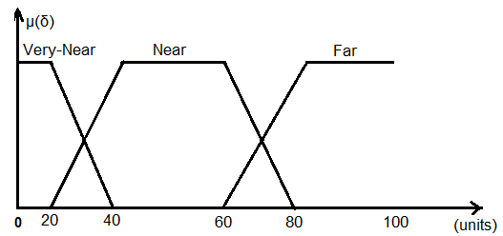
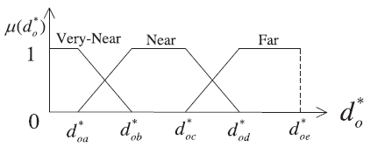
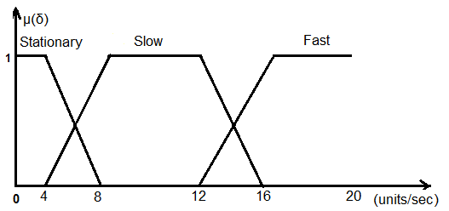
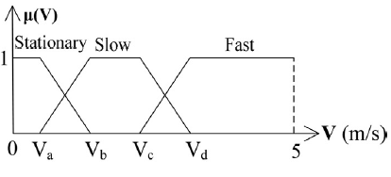
Membership Functions
Distance between object and obstacles
Speed

Slide 11
FUZZY RULES FOR SPEED
(1) IF d* is Very-Near, THEN V* is Stationary;
(2) IF d* is Near, THEN V* is Slow;
(3) IF d* is Far, THEN V* is Fast.

Slide 12
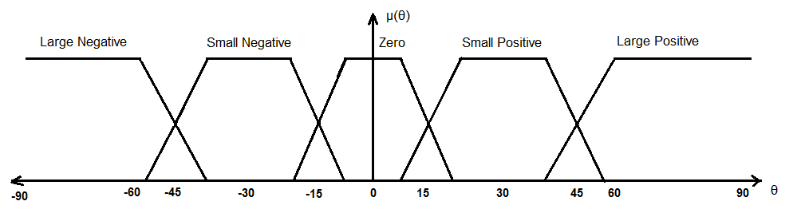
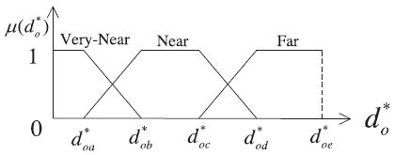
Membership Functions
Turning angle
(Anticlockwise is ‘+’)
2. Distance between
particle and obstacle

Slide 13

DIRECTION CONTROL
Divide the 5 sectors in the 3 parts
Three class will be pl,pr,f.
The minimum particle distance in each class be as in table.

Slide 14
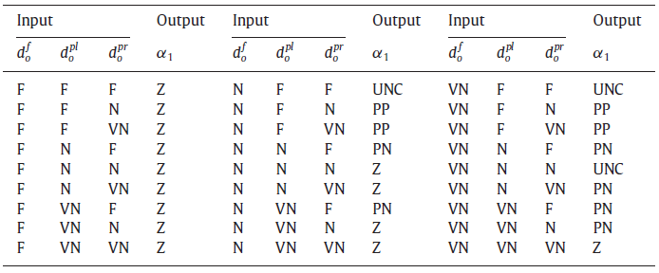
Turning angle output:
Z= Zero
UNC=Uncertain
(We decide it randomly)
3. PP=Prefered+ve
(Turn towards left)
4. PN=Preferred-ve
(Turn towards right)

Slide 15
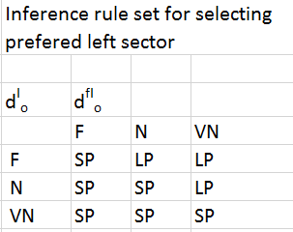
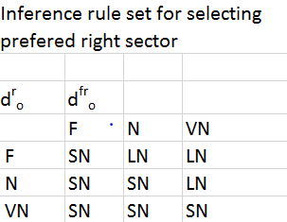
Turning Angle
IF UNC
IF PP
IF PN
FOR UNC SELECT PP OR PN WITH PROBABILITY 0.5

Slide 16
REGIONAL STRATEGY
AIM: We try to find safest and energy efficient path
Strategy:
Avoid areas with large obstacles(IO)
Avoid areas which have higher chance of collision(CR)
Integrate both and find best path(NE)

Slide 17
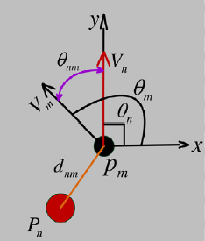
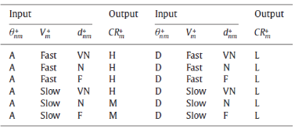
COLLISION RISK

Slide 18
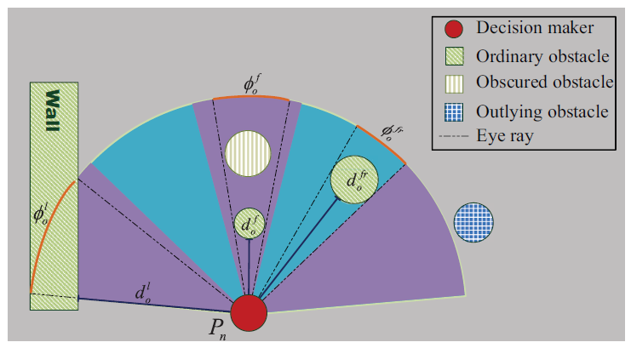
INFLUENCE OF OBJECTS
Inference rules R₂ for influence of an obstacle
d*_{oi} | Ø*_{oi}
 | S | M | L
F | S | S | M
N | S | M | L
VN | M | L | L

Slide 19
TURNING ANGLE AND
SPEED USING NEGATIVE
ENERGY
Inference rule for negative energy
CR* | IO*
 | L | M | S
H | L | L | M
M | L | M | M
L | M | M | S
Calculate NE* for each sector
Deciding SPEED using NE* of front region
Using two layered Fuzzy logic for
TURNING ANGLE

Slide 20
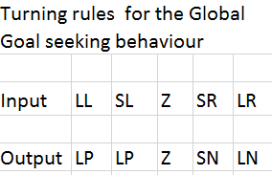
GOAL SEEKING BEHAVIOUR
Turning Angle

Slide 21
Changing Speed
(1) IF d is Far, THEN V is Fast;
(2) IF d is Near AND γ is Zero, THEN V is Fast;
(3) IF d is Near AND γ is not Zero, THEN V is Slow;
(4) IF d is Very-Near AND γ is Zero, THEN V is Fast;
(5) IF d is Very-Near AND γ is not Zero, THEN V is Stationary.
(Here d is distance between goal point and the particle)
(Here γ is the angle between goal point and the direction of velocity )

Slide 22
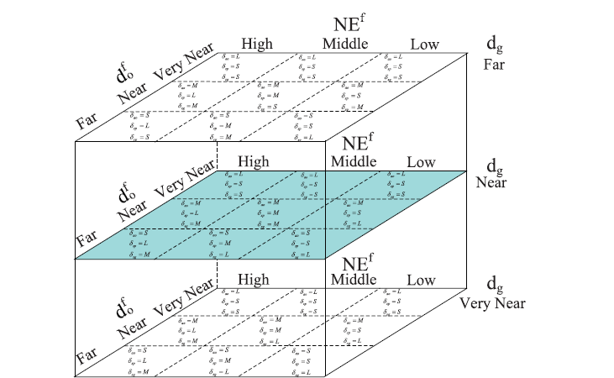
WEIGHTING FACTOR
Weights can’t be constant
Our priorities vary with circumstances

Slide 23
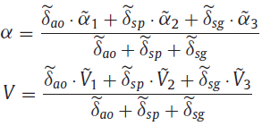
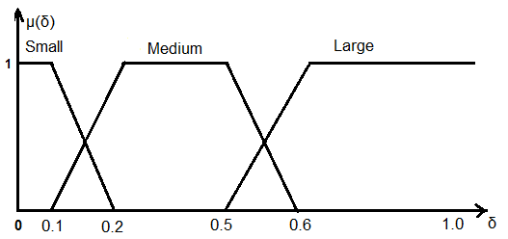
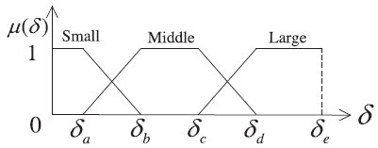
INTEGRATING STRATEGIES
Finally we integrate three output from three strategies using Fuzzified weights (Large,Medium,Small), with membership function as shown.

Slide 24
Assumptions
The possible path to a goal point in a 2D plane
Inertia not maintained (infinite accelerations possible)
Excess frame rate computation (100 per second)
We have inputs from various Sensors.

Slide 25
Applications
Modelling and analysis of emergency exits of systems
Gravitational dominance of multiple goal points
Swarm modelling, many objects with a common goal
Modelling attractive and repulsive nature of charged particles.

Slide 26
Future Works
Dig deeper in each strategy.
Individual testing of each strategy.
Expansion of Model to Automated Robots.

Slide 27
Conclusion
Analysed various Model on Fuzzy human Perception
Categorised problems in Path Planning
We made strategy for each problem
Created Simulation

Slide 28
Thank You

Slide 29
Future Works
Dig Deeper in each Strategy
Individual testing of each Strategy(Simulation)
Expansion of the Model to Automated robots

Slide 30
Conclusion
Our work

